Slide 1
Coin Operated Wi-Fi
Group 5
John Reece Colina
Richard Vergis
Billy Uy

Slide 2
Rationale
Now a days, wireless fidelity or “Wi-Fi” has a great usage in using and accessing the internet. Wi-Fi is a wireless local area network connection that enables wireless devices like cell phones and laptops to connect to a network. People who have gadgets like smart-phones, laptops, android phones and even IOS phones want to connect to Wi-Fi, if there is an available connection, At times but, some routers are configured and secured with a key. Owners want to secure their connection as private and they want fast response from their service provider. When other people connect to the router, the connection speed of the router is divided to all which cause traffic to the network.

Slide 3
There are some people who know the passkey of the
router and share it to other which are a great
disadvantage to the owner. Philippines cannot apply free
Wi-Fi to public, unlike other countries, because the
owners of the network connections pay high rate.
Wi-Fi can be less secured than wired connections (such as Ethernet) because an intruder does not need a physical connection. Web pages that use SSL are secured, but unencrypted internet access can easily be detected by intruders. Because of this, Wi-Fi has adopted various encryption technologies. The early encryption Wired Equivalent Privacy (WEP) is proven easy to break. Higher quality protocols as Wi-Fi Protected Access (WPA) and Wi-Fi Protected Access II (WPA2) were added later. These are the common problems of the users of unknown users.

Slide 4
The “Coin Operated Wi-Fi” is a system that will give fairness to the users of the internet. It will help people connect their devices to the internet from a private network with the price that people will agree with. It gives people different ways of payment like hourly, daily and monthly to suit their needs. Owners can also manage this system remotely from their computer so that updates can be managed securely from the public. This will be of help to the needs of some people in connecting to secure wireless local area network (WLAN) and gives the owner the right for his router or service provider. People will be able to use a system with the satisfaction of service in accordance to the price.

Slide 5
Scope of the problem
The purpose of the Coin Operated Wi-Fi is to address the problem of unauthorized connectivity on the router. This system will address the following questions:
Is there a great necessity of internet connection to the public?
What are the common types of Internet connecting devices used in wireless local area network?
What are the common problems encountered when connecting to a private wireless local area network?

Slide 6
Research Methodology
In order to meet the team’s output, steps and methods are to be implemented. These include the research environment, research respondents, research instruments and research procedures.

Slide 7
Conclusion and Recommendation
CONCLUSION
Based on the findings of the study, the team concluded that connecting Wi-Fi have issues in catering to the needs of the users. They cannot connect when there is password or when get connected but the speed is slow. They go to the internet provider to have a plan or buy devices with a higher cost just to connect to the internet.
The team concluded that developing “Coin Operated Wi-Fi” can make the users satisfied in the performance of their connection with given password and less cost, making it more convenient.

Slide 8
RECOMMENDATION
Technology is developing fast in business where the needs of consumers constantly change. The team must have such knowledge in familiarizing the characteristics of the components, seeing to it that the components are reliable and such components could give the exact data to maximize the capability of the system. The team suggested that testing the system is necessary from time to time if there is a module being accomplished. The team also recommends to the future team that doing more research could bring out a lot of ideas. The system’s capability can be modified to meet the new demands of the customer and therefore increases its marketability. To the future developers, the team highly recommends adding up a bill acceptor.

Slide 9
With this, problems regarding coins will be reduced.
Through the use of the technology and some marketing techniques, the system could be well developed and be enhanced for greater customer satisfaction.

Slide 10
System Flow chart

Slide 11
Program Flow chart

Slide 12
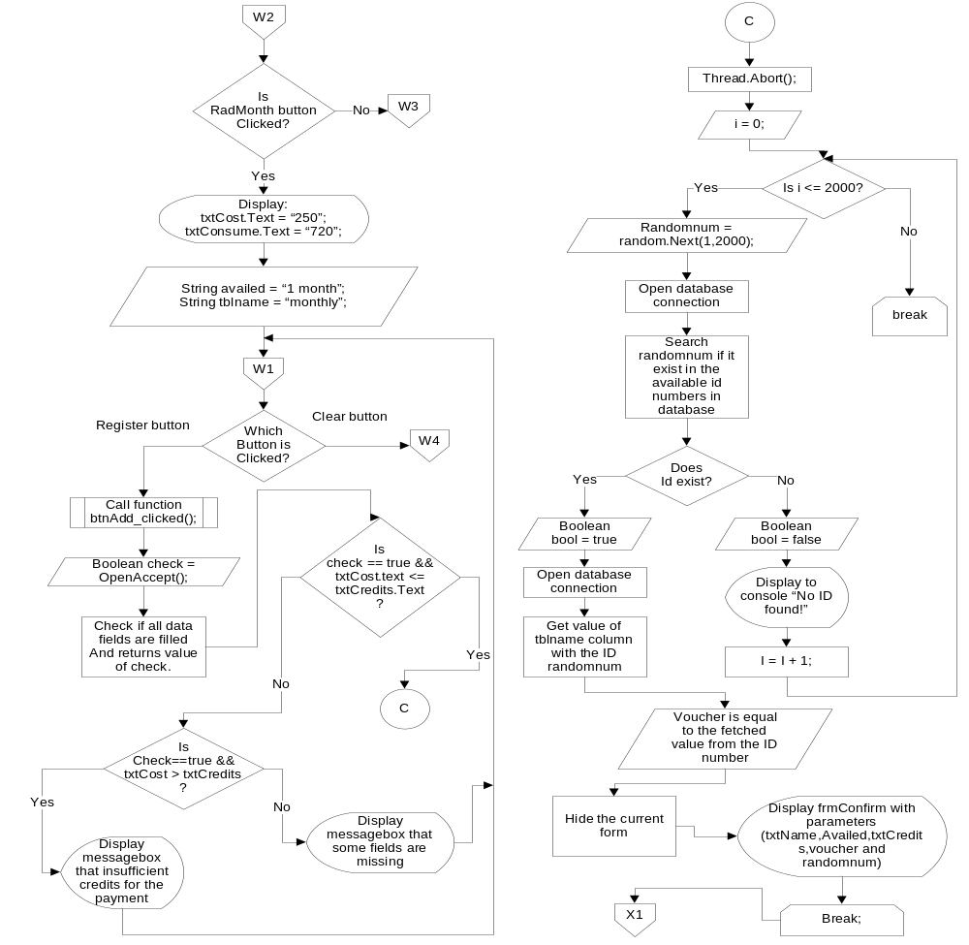

Slide 13
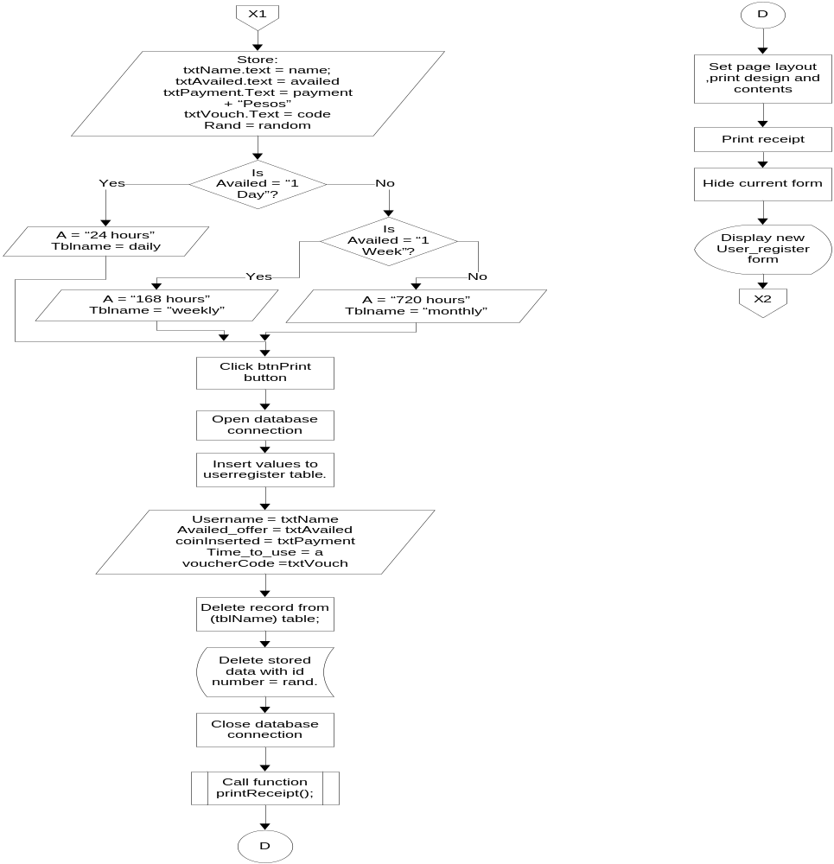

Slide 14
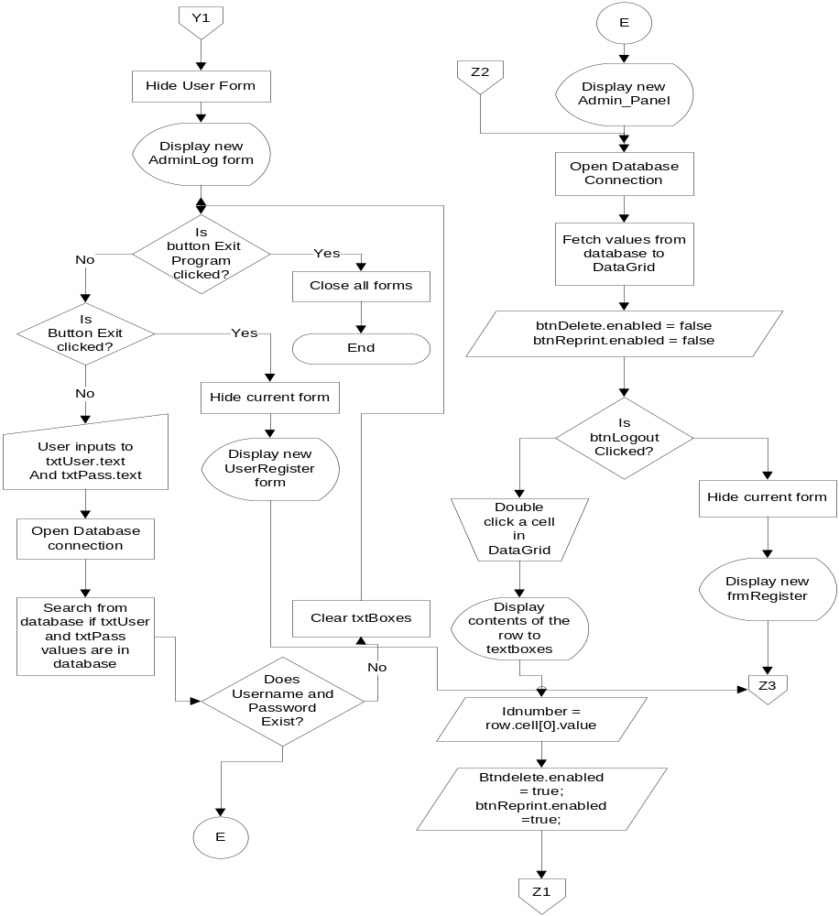

Slide 15
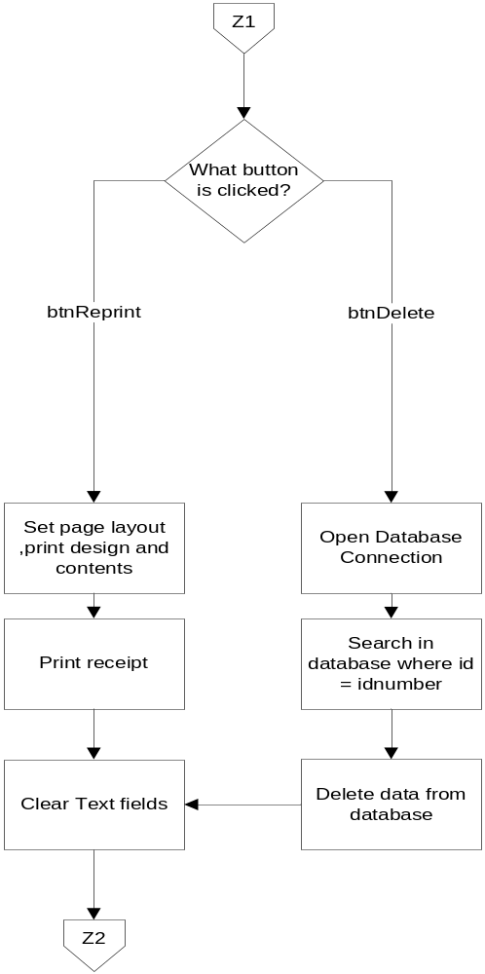

Slide 16
Features
Print Receipt for Transactions with the code
Offers Daily, Weekly and Monthly
Accept Php 1, Php 5 and Php 10 coins
Reprint Transactions
Touch-screen
Range 20-30 meters
Remote Access by the admin

Slide 17
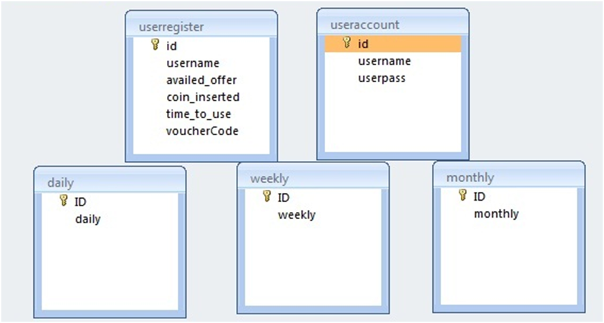
Database diagram

Slide 18
Source code

